Slide 1
Root Anatomy and Functions

Slide 2
ROOTS
Root system consists of primary and secondary roots.
The root is made up of dermal, vascular, and ground tissues.
Roots absorb water and minerals and transport them to stems. They anchor and support a plant, and store food.

Slide 3
Parts of a root
Primary root = Taproot

Slide 4
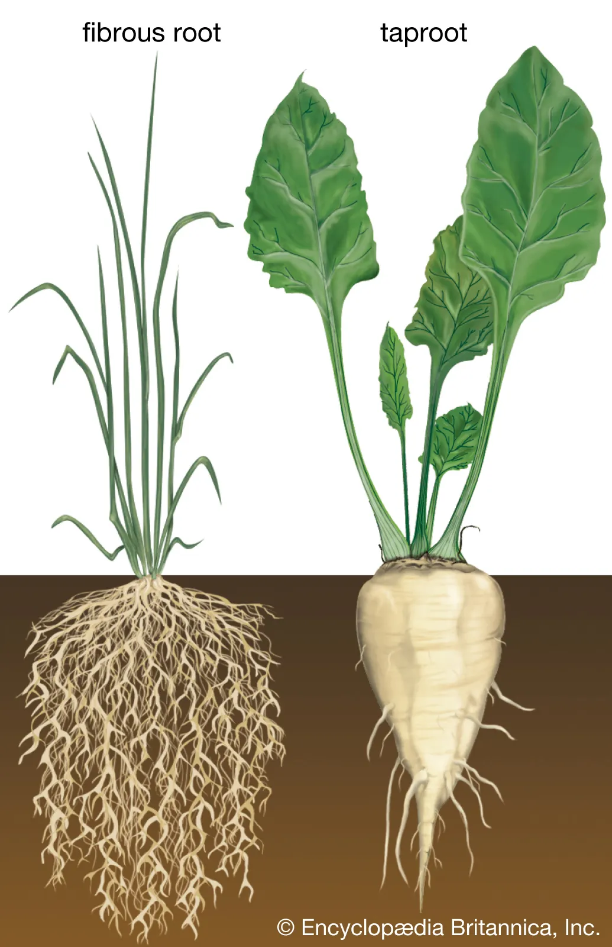
Fibrous Root
Taproot
Branched root that arises from the base of the stem
Straight root that grows vertically downward.

Slide 5
Food Storage
Roots can store some of the energy created by plants during photosynthesis.
Energy becomes available as the plant needs it.
(Taproots or root vegetables)

Slide 6
Roots work to anchor the plant to the ground
Roots also absorb water and minerals for the plant from the soil

